Slide 1

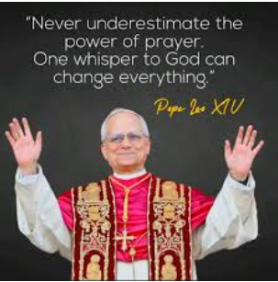
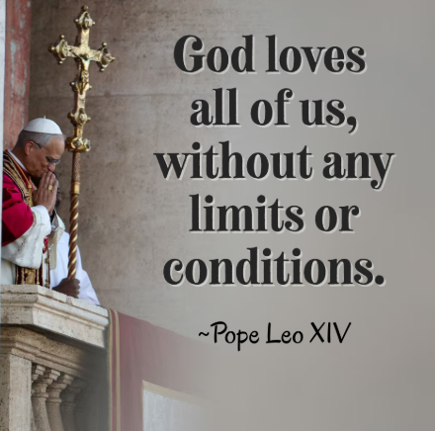
Prayers

Slide 2

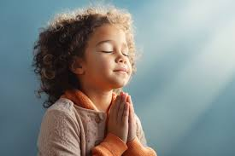
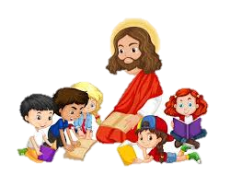
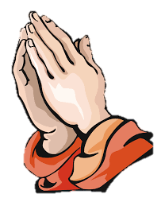
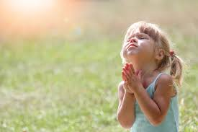
Prayers for
EYFS and KS1

Slide 3

The Sign of the Cross (Nursery)
From my head to my heart
to my shoulder to my shoulder
Jesus loves me.

Slide 4
The Sign of the Cross
In the name of the Father
and of the Son
and of the Holy Spirit.
Amen.

Slide 5
School Prayer
This is our school.
Let peace bloom here.
Let the rooms burst with happiness.
Let love shine here,
love for each other, love of life itself and love of God, Amen

Slide 6
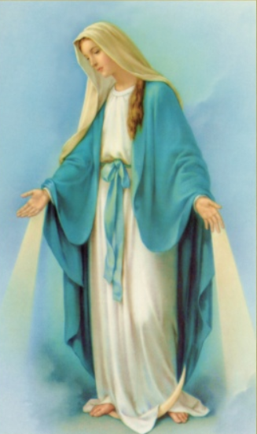
Lovely Lady
Lovely Lady dressed in blue
Teach me how to pray!
Your little Son was Jesus,
and You Know the way!
Amen

Slide 7
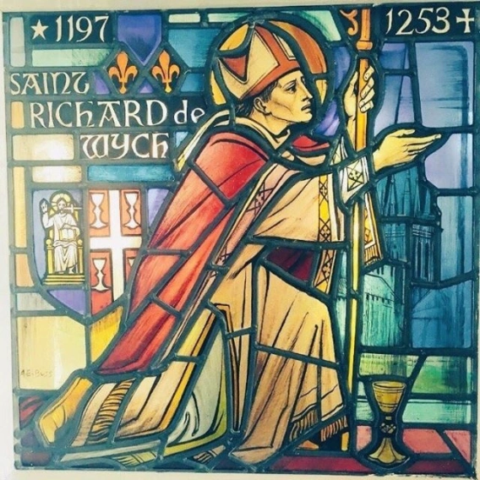
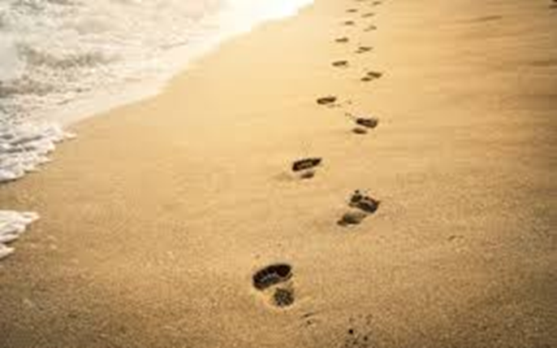
St Richard of Chichester Prayer
Dear Jesus
May I know you more clearly,
Love you more dearly, and
Follow you more nearly,
Day by day. Amen.

Slide 8
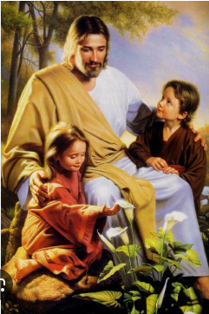
The Lord’s Prayer
Our Father who art in heaven,
hallowed be thy name.
They kingdom come.
Thy will be done on earth,
as it is in heaven.
Give us this day our daily bread,
and forgive us our trespasses,
as we forgive those who trespass against us,
and lead us not into temptation,
but deliver us from evil.

Slide 9
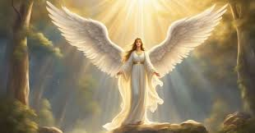
Angel of God
Angel of God, my guardian dear,
to whom God’s loves commits me here,
ever this day be at my side,
to light and guide, to rule and guide.
Amen

Slide 10
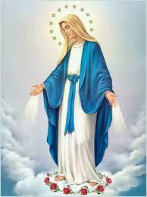
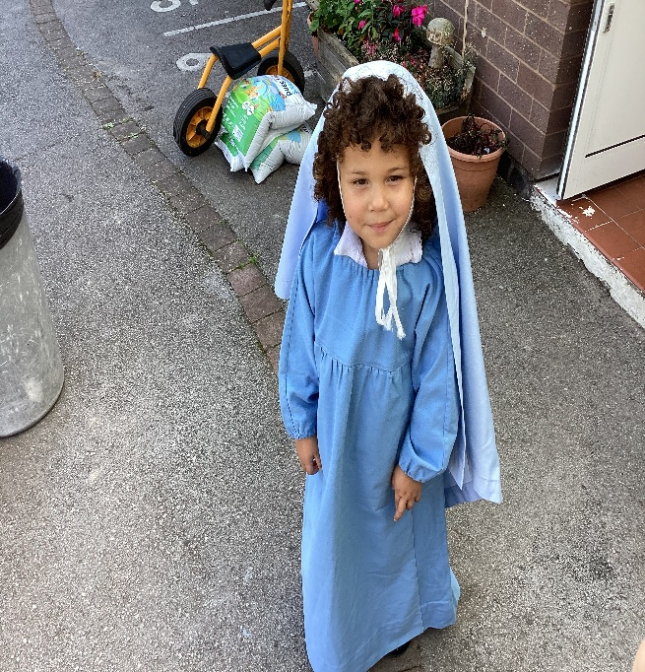
The Hail Mary
Hail, Mary, full of grace,
the Lord is with thee.
Blessed art thou among women
and blessed is the fruit of thy womb, Jesus.
Holy Mary, Mother of God,
pray for us sinners,
now and at the hour of our death.
Amen

Slide 11

Glory be to the Father
Glory be to the Father
and to the Son
and to the Holy Spirit,
as it was in the beginning
is now, and ever shall be
world without end.
Amen

Slide 12
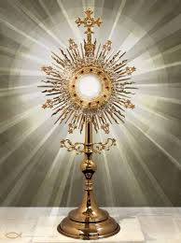
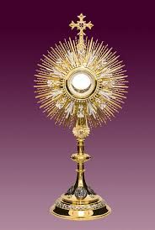
O Sacrament most holy, O Sacrament divine! All praise and all thanksgiving
Be every moment thine

Slide 13
Prayers for Years 3 and 4

Slide 14
The Apostle’s Creed
I believe in God,
the Father almighty
Creator of heaven and earth,
and in Jesus Christ, his only Son, our Lord,
who was conceived by the Holy Spirit,
born of the Virgin Mary
suffered under Pontius Pilate

Slide 15
was crucified, died and was buried;
he descended into hell;
on the third day he rose again from the dead;
he ascended into heaven,
and is seated at the right hand of God the Father almighty;
from there he will come to judge the living and the dead.

Slide 16
I believe in the Holy Spirit,
the holy catholic church,
the communion of saints,
the forgiveness of sins,
the resurrection of the body,
and life everlasting.
Amen

Slide 17

Act of Contrition (saying sorry)
O my God,
Because you are so good,
I am very sorry that I have sinned against you,
And with the help of your grace
I will try not to sin again.

Slide 18
Angel of God
Angel of God, my guardian dear,
to whom God loves commits me here,
ever this day be at my side,
to light and guide.
Amen

Slide 19
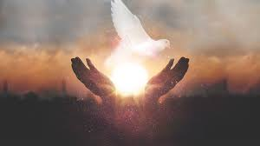
Come Holy Spirit
V. Come, Holy Spirit, fill the hearts of your faithful
R. And kindle in them the fire of your love.
V. Send forth your Spirit and they shall be created

Slide 20
R. And you will renew the face of the earth.
Let us pray
O God, who by the light of the Holy Spirit,
did instruct the hearts of your faithful,

Slide 21
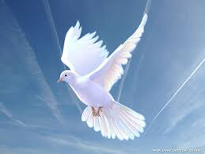
grant that by the same Holy Spirit,
we may be truly wise, and ever rejoice in your consolation,
through Christ our Lord.
Amen

Slide 22
Prayer of St Richard of Chichester
Thanks be to you, my Lord Jesus Christ,
for all the benefits which you have given me,
for all the pains and insults which you have borne for me.
O most merciful Redeemer, friend and brother

Slide 23


May I know You more clearly,
love You more dearly
and follow You more nearly,
day by day.
Amen

Slide 24
O Sacrament most holy, O Sacrament divine! All praise and all thanksgiving
Be every moment thine

Slide 25
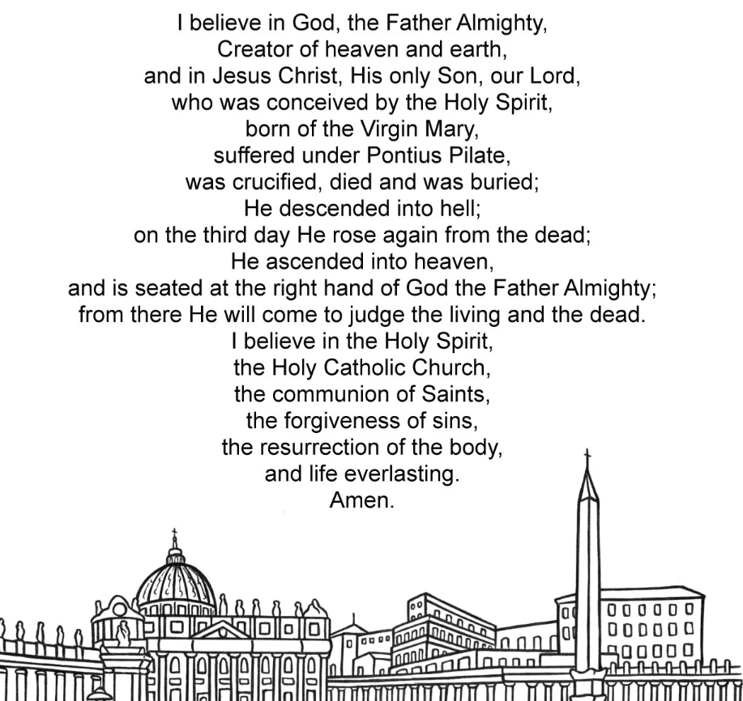
The Apostles’ Creed

Slide 26
Prayers for Year 5 and Year 6

Slide 27
The Magnificat
My soul proclaims the greatness of the Lord,
my spirit rejoices in God my Saviour,
for he has looked upon his handmaid in her lowliness;
for behold and from this day forward,
all generations will call me blessed.

Slide 28
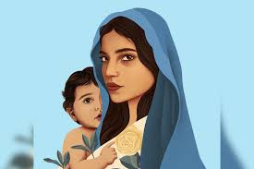
For the Almighty has done great things for me,
and holy is his name.
His mercy is from age to age
for those who fear him.

Slide 29
He has made known the strength of his arm,
and has scattered the proud in their conceit of heart.
He has cast down the mighty from their thrones
and has exalted those who are lowly.
He has filled the hungry with good things,
and has sent the rich away empty.

Slide 30
He has helped his servant Israel,
mindful of his mercy,
even as he promised to our fathers,
to Abraham and his descendants forever.
Glory be to the Father and to the Son
and to the Holy Spirit,
as it was in the beginning, is now,
and every shall be, world without end.
Amen

Slide 31
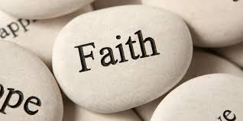
Act of Faith
My God, I believe in you
and all that your Church teaches,
because you have said it,
and your word is true.

Slide 32

Act of Hope
My God, I hope in you,
for grace and for glory,
because of your promises,
your mercy and your power.

Slide 33

Act of Love
My God, because you are so good,
I love you with all my heart,
and for your sake,
I love your neighbour as myself.

Slide 34
O Sacrament most holy, O Sacrament divine! All praise and all thanksgiving
Be every moment thine

Slide 35
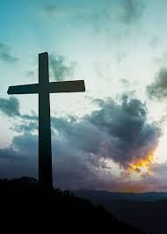
Eternal rest
Eternal rest grant unto them, O Lord,
and let Your perpetual light shine upon them.
May their souls and the souls of all the faithful departed
rest in peace.
Amen.

Slide 36
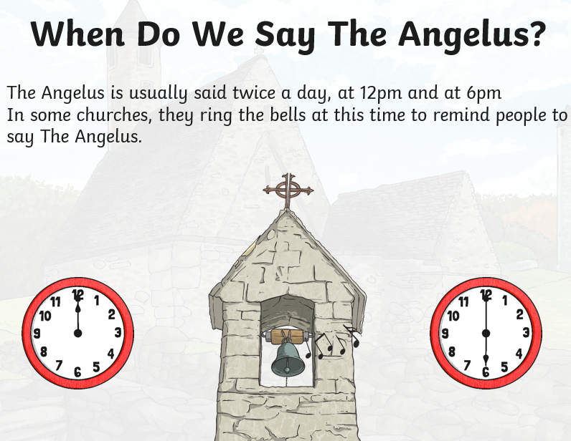
The Angelus

Slide 37
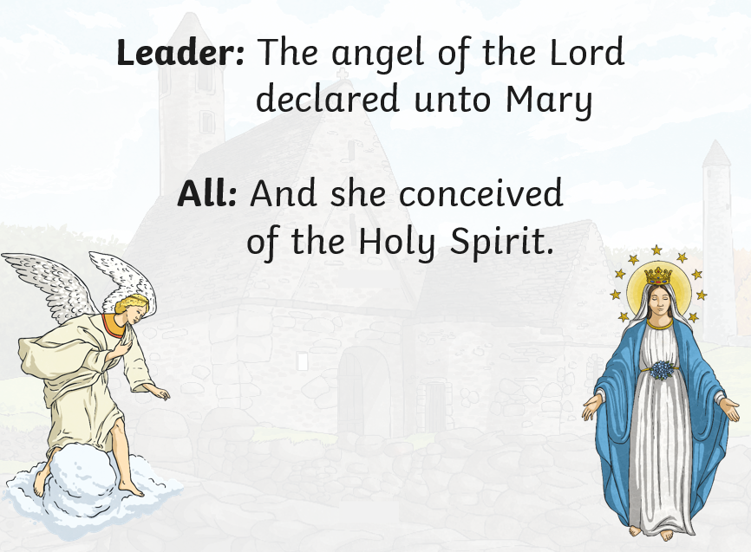

Slide 38
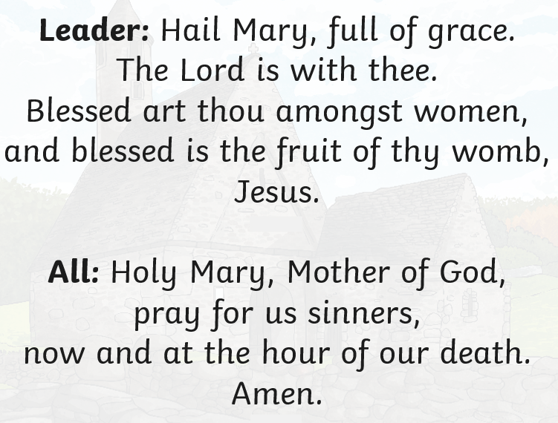

Slide 39
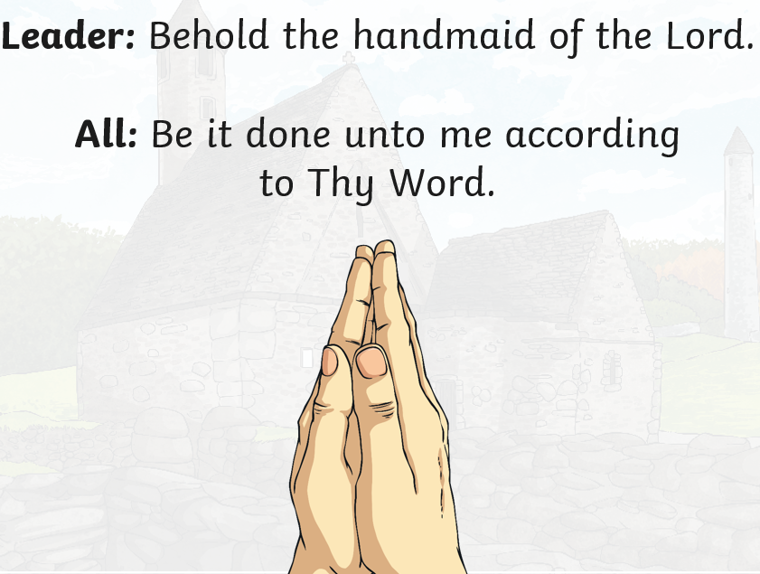

Slide 40
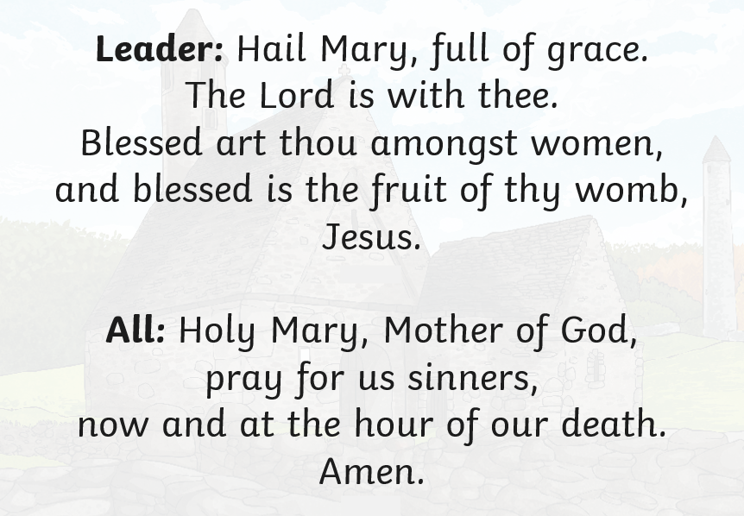

Slide 41
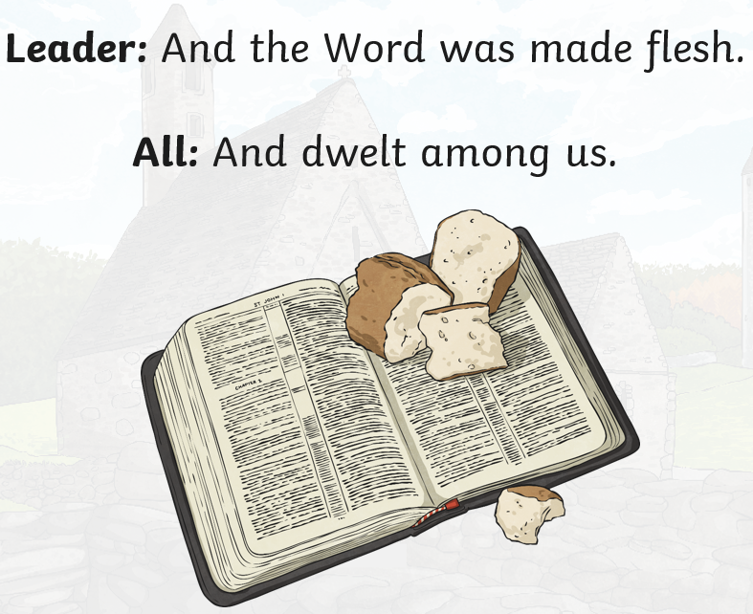

Slide 42
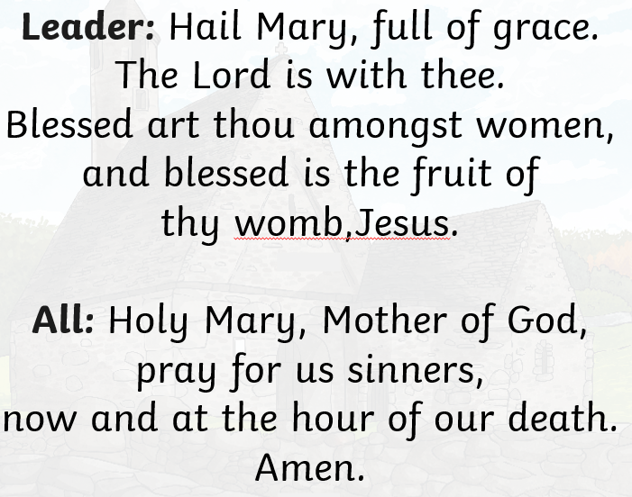

Slide 43


