Slide 1
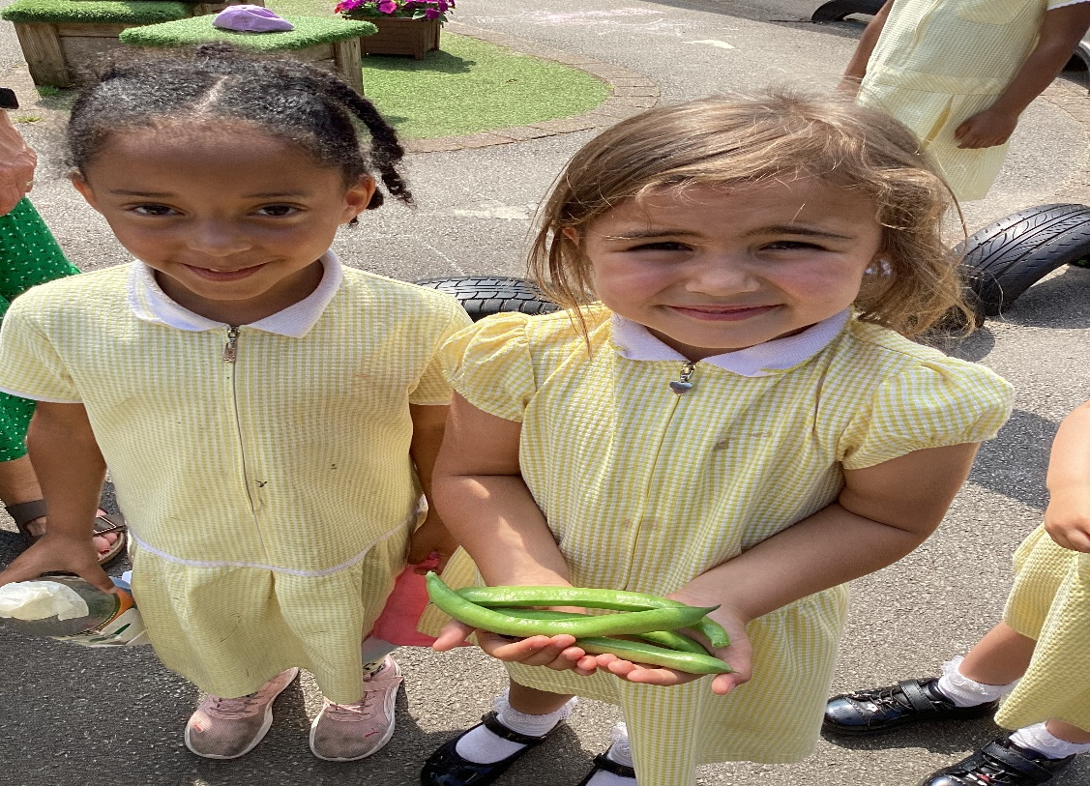
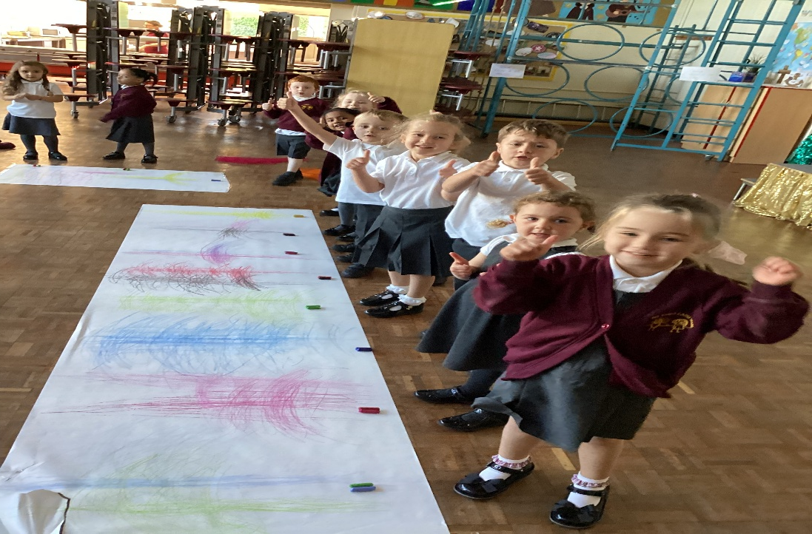
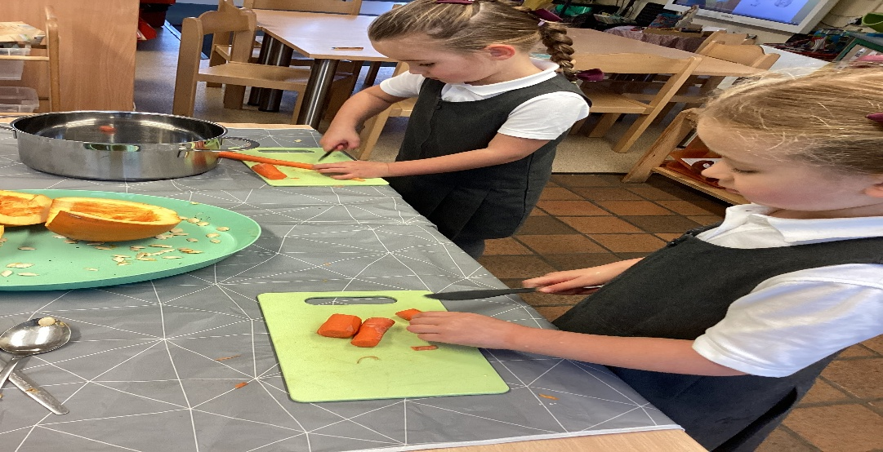
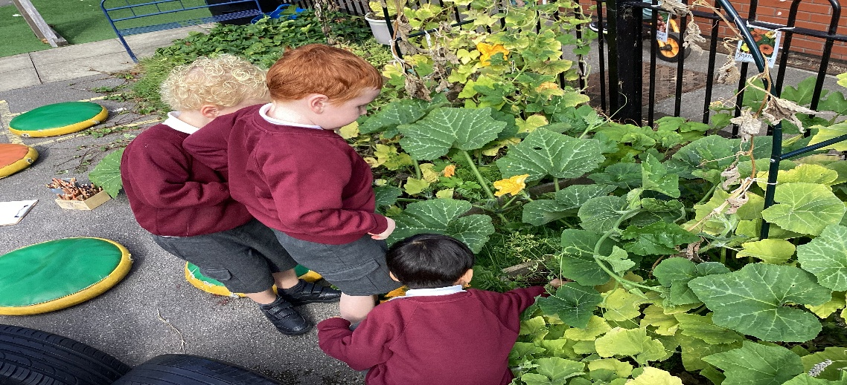
All Saints’ Early Years Foundation Stage
‘Living our Faith Learning in Love’

Slide 2
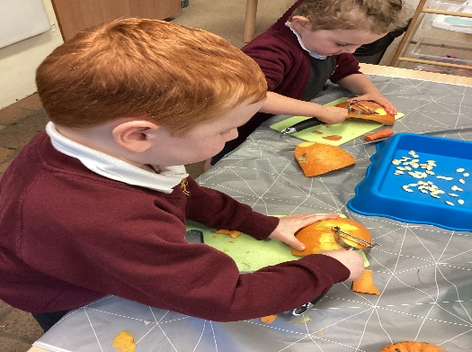

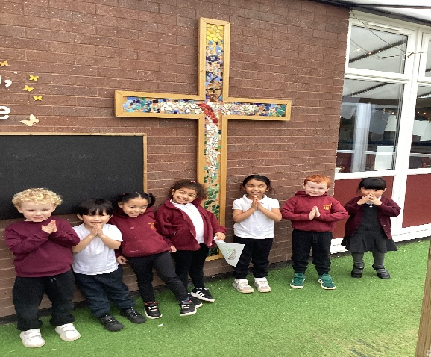
Welcome to All Saints’ Primary School
We are looking forward to welcoming your child into Reception in September 2026

Slide 3


In the EYFS at All Saints’ we aim to support and nurture the holistic development of each pupil
Recognising that all children are individuals
Providing a safe, secure and caring environment where children feel happy and know that they are valued.
Developing pupil’s understanding of social skills and positive behaviour expectations.
Providing quality, play based learning experiences which use the interests and curiosities of pupils in order to foster motivation to explore and learn.
Develop and encourage independence and choice making skills as appropriate to each pupil.
Providing a curriculum which takes account of, and responds to, the pupil’s developmental needs and allows them to make progress related to their differing abilities. “What the child can do” will be our starting point.
Ensuring pupils have positive experiences of success at their own levels in order to give them confidence and motivation for learning in the future.
Providing a broad, balanced, relevant and creative curriculum which promotes the ‘Early Learning Goals’ .
Creating partnerships with parents to support and enhance the development of pupils.

Slide 4
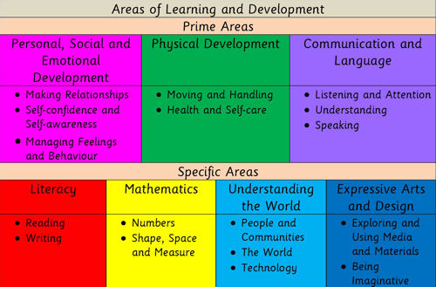
Curriculum Areas

Slide 5
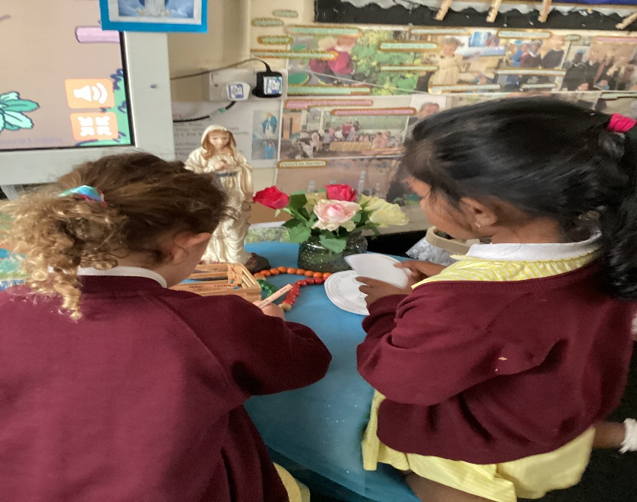
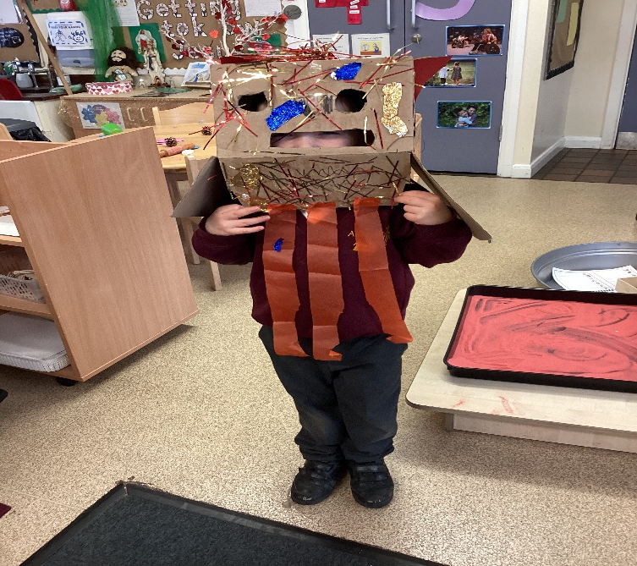
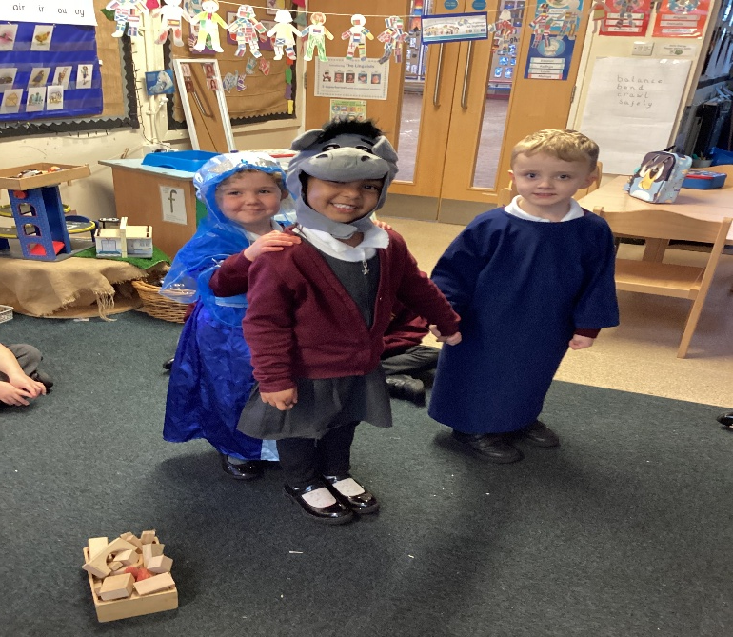
Arrival and Collection
Reception doors open at 8.45am. Each day, we have a morning challenge activity for your child to complete when they arrive. If you need to speak to a member of staff, the morning is a good time to do this (although we are happy to set up meetings at different times for your convenience).
Our school day starts at 8.55am. It is important that all children are in the class by this time so that our learning can begin promptly.
The day ends at 3.15 pm.
Children are dropped off and collected directly from the EYFS gates

Slide 6
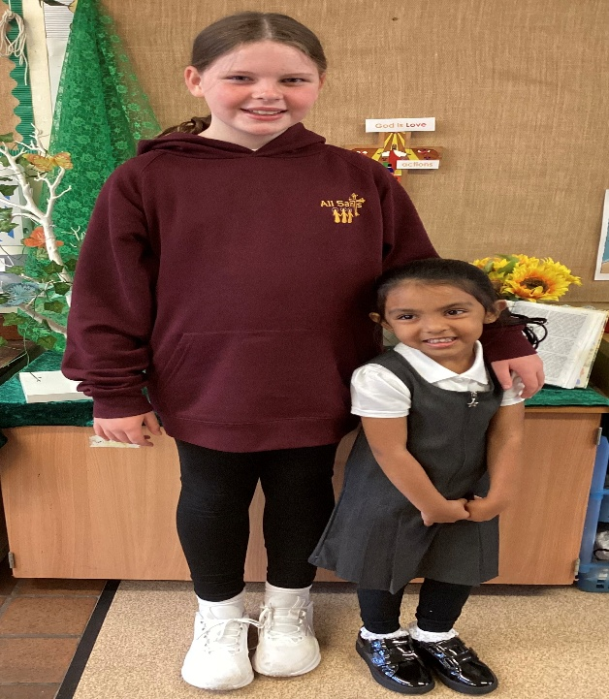
Year 6 Buddy System
Each Reception child is assigned a ‘Year 6 Buddy’.
We are very proud of our buddy system at All Saints’ which we have developed and refined over a number of years. Our system is used to help our new Year Reception children start school confidently and enthusiastically with a sense that someone is always there who will look after them. It is rooted in our school vision of love and care - to form strong, genuine relationships.
Buddy System aims to enhance the learning in:
Positive role modelling
Taking responsibility
Being caring
Feeling valued
Security
Relationships
Increasing self-esteem and confidence

Slide 7
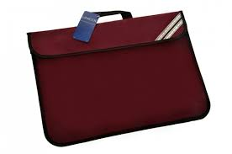
*All children require a book bag to carry Reading Records, School Letters and work etc. to and from school and home.
*Please ensure you purchase a flat book bag and not a back pack . The book bags fit in the home tray perfectly whereas the bag packs do not unfortunately
*Please name the book bag. Some parents like to attach a key-ring or decoration so that their child can immediately identify their own book bag.
*Book bags must be brought to school every single day.
*Please check them at home daily for any school letters or messages and to check Reading Records.
Book Bags

Slide 8
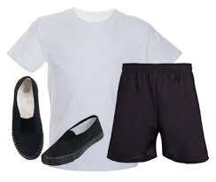
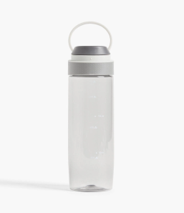
Water Bottles and PE Kits/Uniform
*All children are encouraged to bring in a NAMED water bottle which can be taken home each day to be refilled.
*There should only be water in the water bottle not squash please.
*Reception will be starting PE lessons after Christmas .
* Trainers maybe worn on PE day.
*Please ensure All Uniform (shoes too) is named in permanent marker or with a name label.
*We will write names into any unnamed jumpers/cardigans that we find.
* Please provide a pair of wellington boots for our forest school activities

Slide 9

Snacks
We will provide the children with a small snack mid-morning
We also have a fruit snack in the afternoon.
Fruit/Veg snacks are provided for all EYFS Key Stage 1 children through a government scheme to help promote Healthy Eating. The snack is always a piece of fruit or vegetable, usually either an apple, banana, carrot, tomato, orange or raisins. We never know what will arrive – it is a surprise!

Slide 10
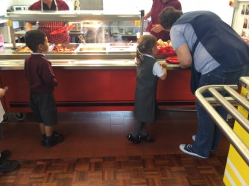
Lunchtime
All the children eat their meals in the School Hall and sit with their friends when eating. Reception are the first to arrive in the hall so that the children have time to get their school dinners or start their packed lunches before the older children arrive. We ensure that the class sit together as going to the dining room can be a bit daunting for the children at first. Reception has their own lunchtime supervisor who will look after them during lunchtime. When the children finish their lunch they will be able to play outside on the yard with Key Stage One pupils until lunchtime is over.
All Reception, Year 1 and Year 2 children are eligible to receive a free school meal.
Children can choose to bring a packed lunch if they wish.
The menu is available online.

Slide 11
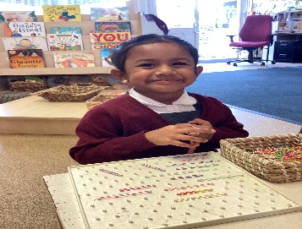
.
How can I help my child prepare for school…
Support your child to be confident about getting to the loo in time and wiping properly, using toilet paper.
Chat about the importance of good handwashing with soap and water, especially after going to the toilet.
Let your child practise putting on their school clothes, taking them off and folding them neatly.
Clothes with elasticated waist bands and shoes with Velcro are easier to handle for young children.
Children having school dinners need to be able to use a full-sized knife and fork and carry a plate or tray. If your child is taking a lunchbox, make sure they can open it as well as any containers and packets inside.
Introduce your child to the routine of ‘catch it, bin it, kill it’ – catching their sneeze or runny nose in a tissue, putting it in the bin straightaway, then washing hands to kill germs. Some children find nose-blowing difficult, so play games to practise nose control – blowing a feather into the air, for example.
Encourage them to be independent and able to look after themselves

Slide 12
More Top Tips…
Name EVERYTHING in permanent marker with your child’s name and class. Biro washes off very quickly. Coats, hats, gloves, PE bag, PE kits, plimsolls, JUMPERS, school shirts, trousers. Alternatively you can buy iron-on or even better stick-on name labels online.
Please check that your child’s winter coat has a zip that is easy to do up. Some zips are impossible for the child to do themselves! Practise putting on and doing up coats, it is really helpful as it develops children's sense of independence.
When choosing school shoes, ones with Velcro instead of shoelaces are helpful for younger children. Shoes need to be sensible, flat, black shoes – no sandals or open-toed shoes please.
Get your child into the habit of hanging their coat up, putting their toys away, clearing the table, and so on, to prepare them for doing these things at school. Why not turn it into a game?
Encourage them to be independent and able to look after themselves

Slide 13

Between now and September...
As well as promoting all the self care please also encourage …
Lots of counting, both reciting and counting objects accurately.
Learning to recognise numbers.
Lots of drawing, colouring, Play dough and Lego to help build up hand strength.
Encourage name recognition and also please practise writing their name.
Lots of talking; promoting communication by discussing what you do over the summer etc.
Sing nursery rhymes and read lots of stories.
We follow the Read Write Inc Phonics scheme. Please purchase the pack below ,if you can .
These can be purchased on Amazon…

Slide 14


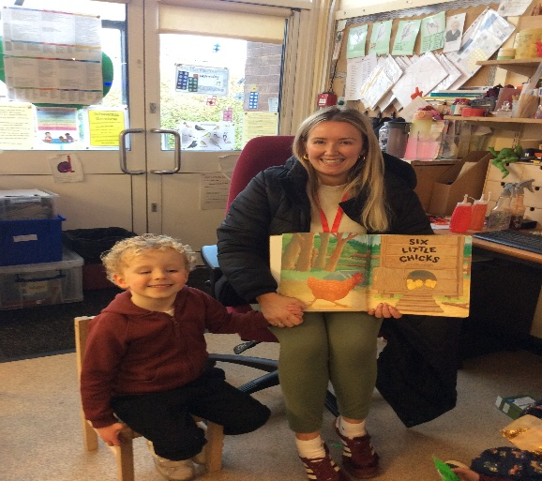
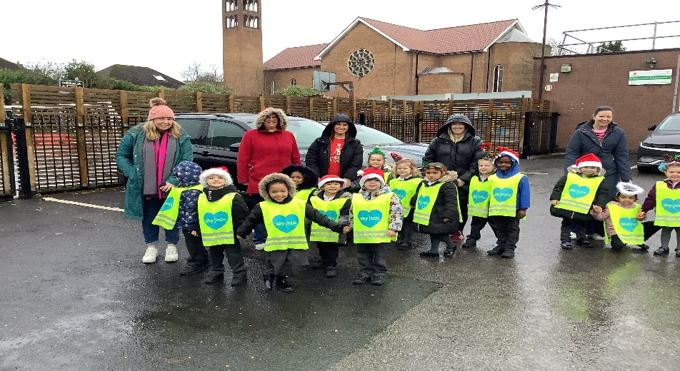
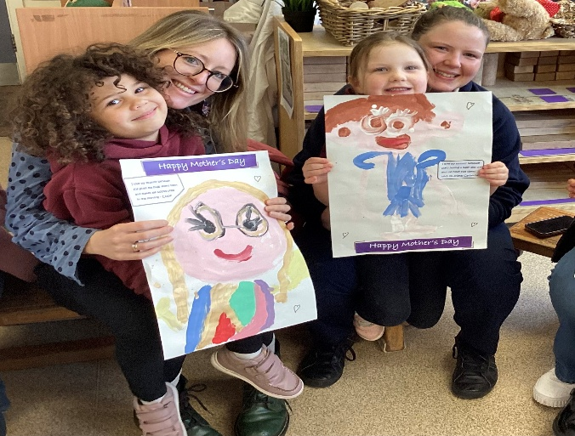
Parent Partnership
Children do best when parents and our school work together.
It is important to remember that you know more about your own child than anyone else does.
We will be asking you about your child and sharing information with you about your child’s progress.
Parents will be invited into school throughout the year to spend time in our classroom with their child.
The part you play in their learning and the choices we make collectively will make a difference to their future.

Slide 15
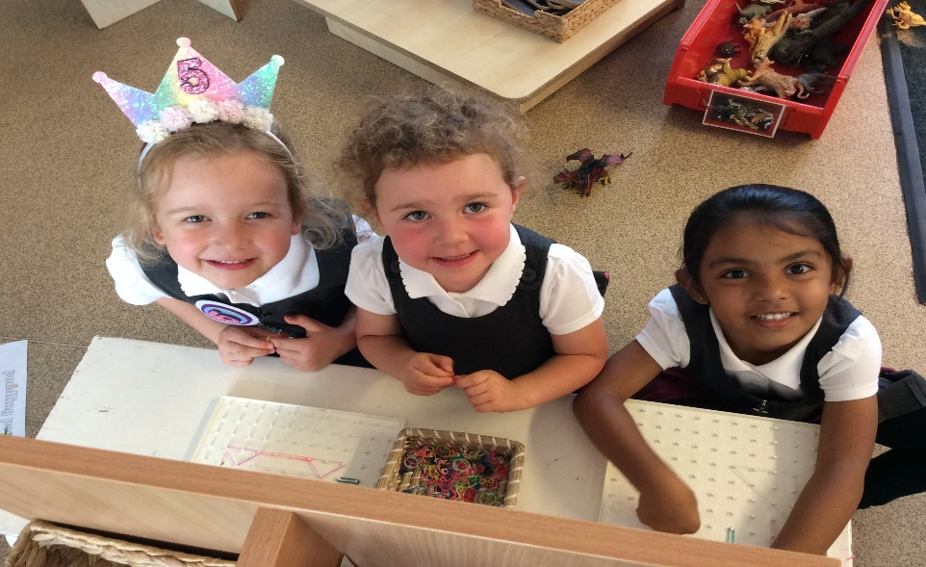
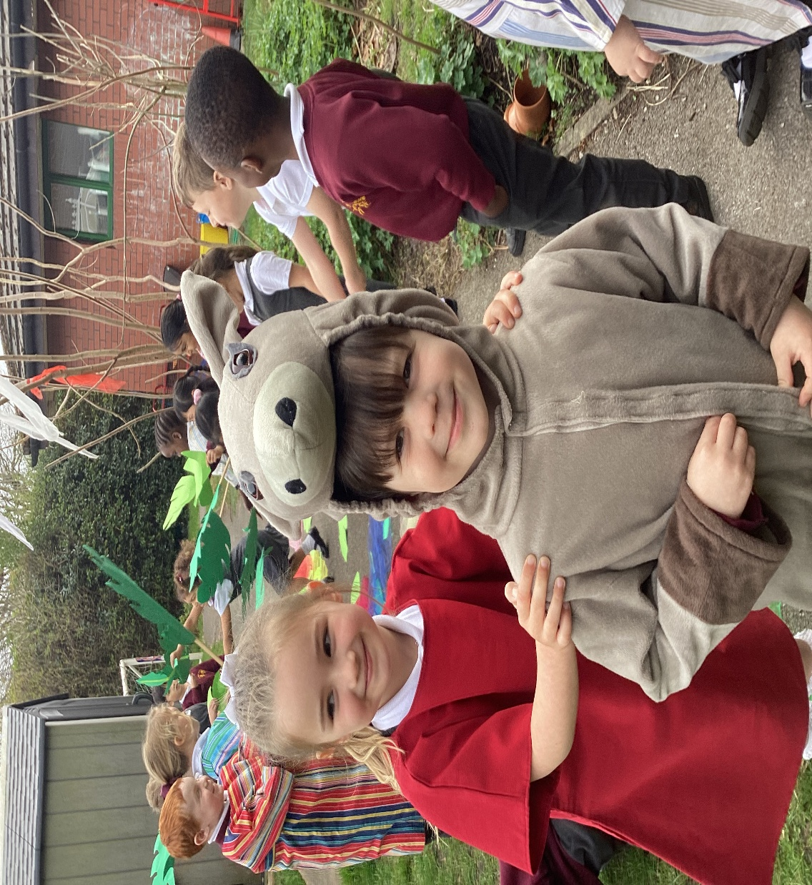
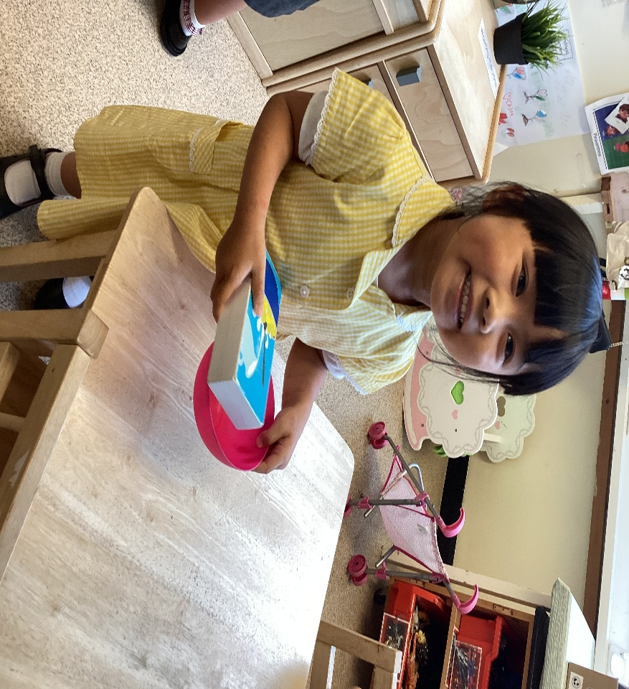
Follow us and see what we get up to…
Our school website
www.allsaints.trafford.sch.uk

Slide 16
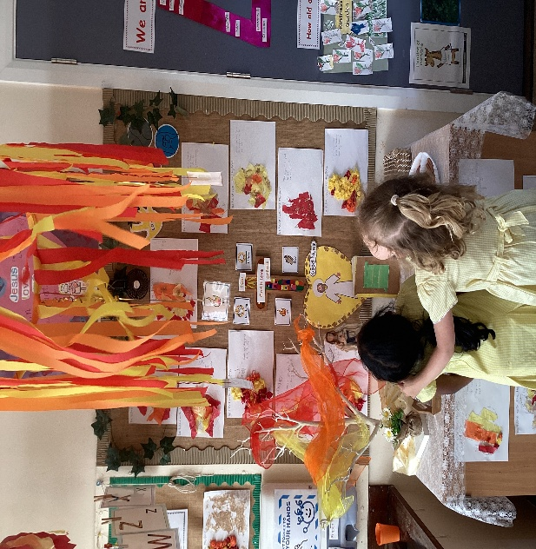
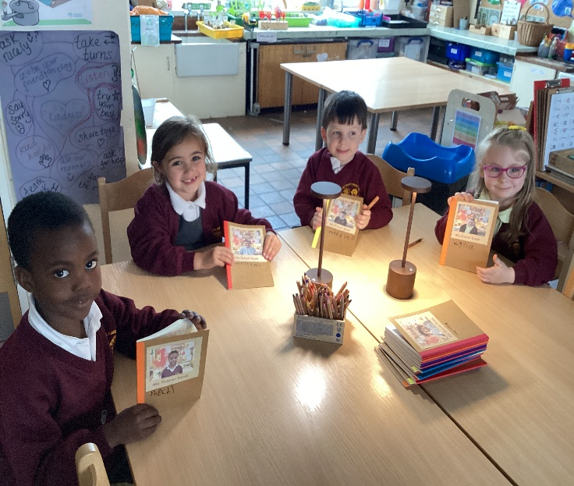
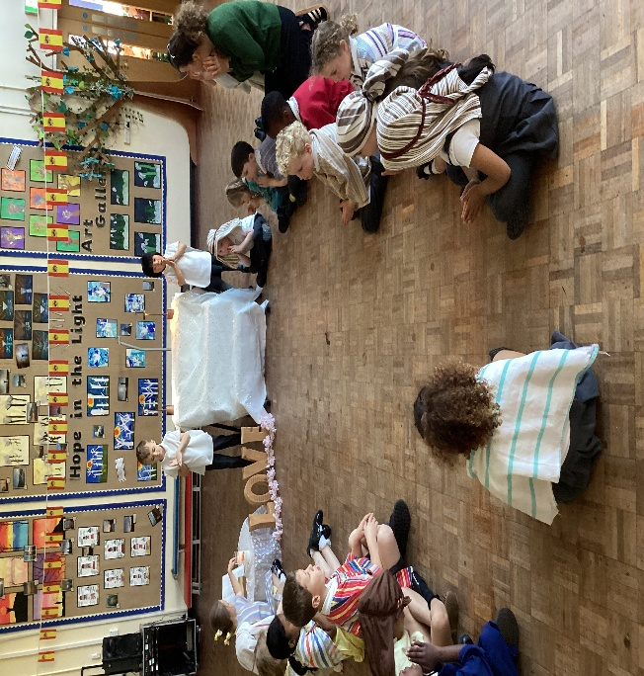

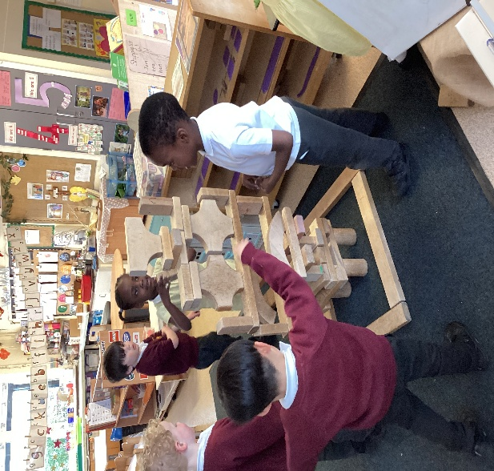
And Finally
Get excited!
Look forward to starting school
We can’t wait to join you on your learning journey

