Slide 1
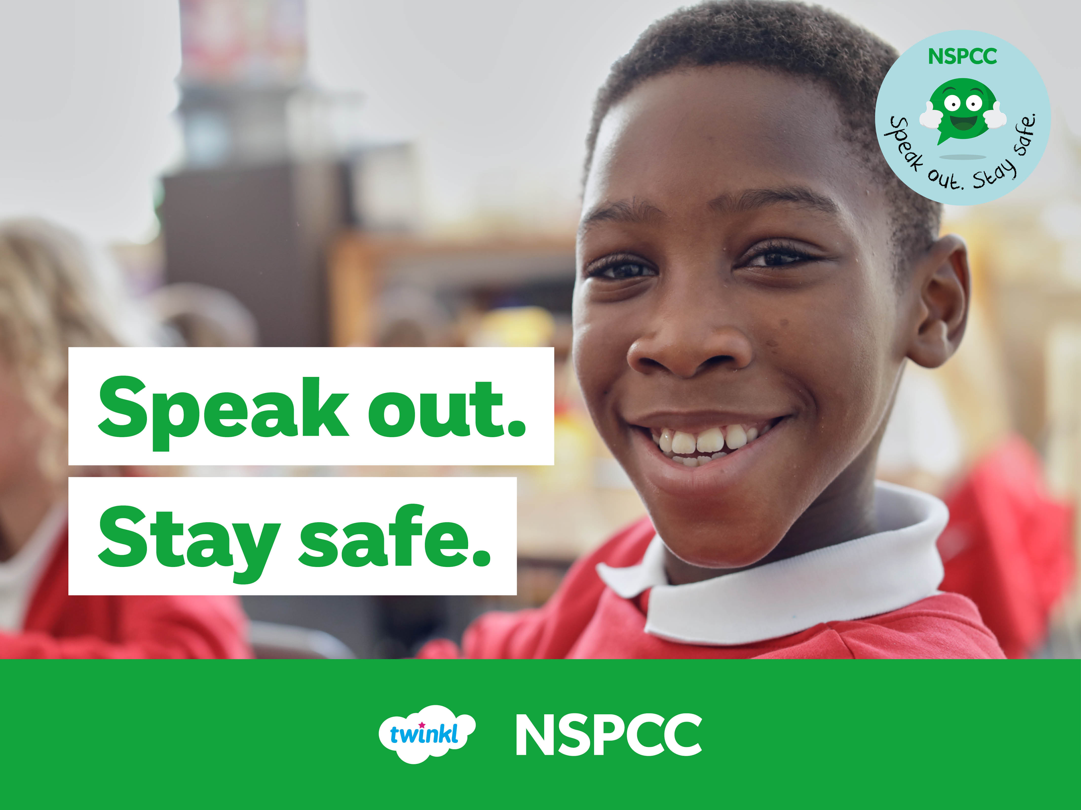

Slide 2
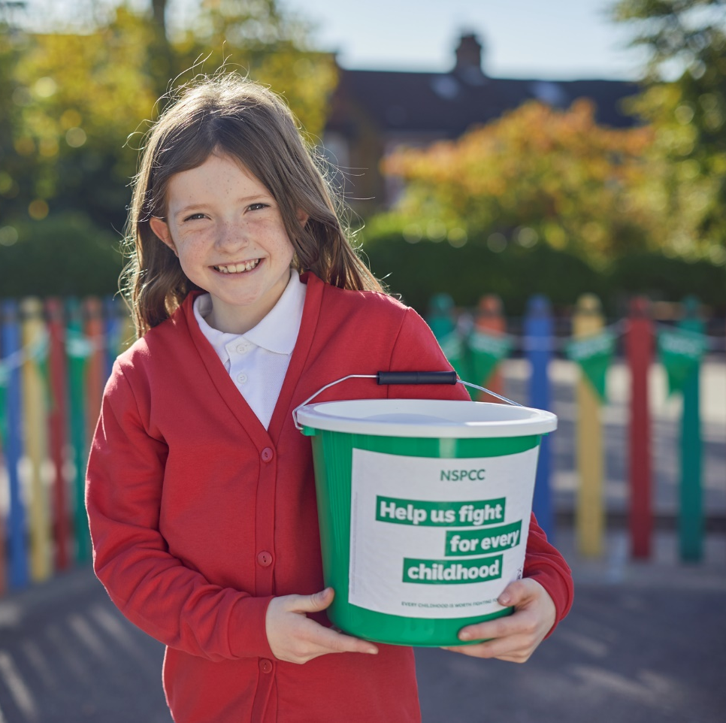
About the NSPCC
The NSPCC is the National Society for the Prevention of Cruelty to Children. It is the UK's leading children's charity and has been looking out for children for over 130 years.
The NSPCC supports children in lots of different ways: by visiting schools, supporting families, talking to politicians and campaigning for change to make children’s lives better.

Slide 3
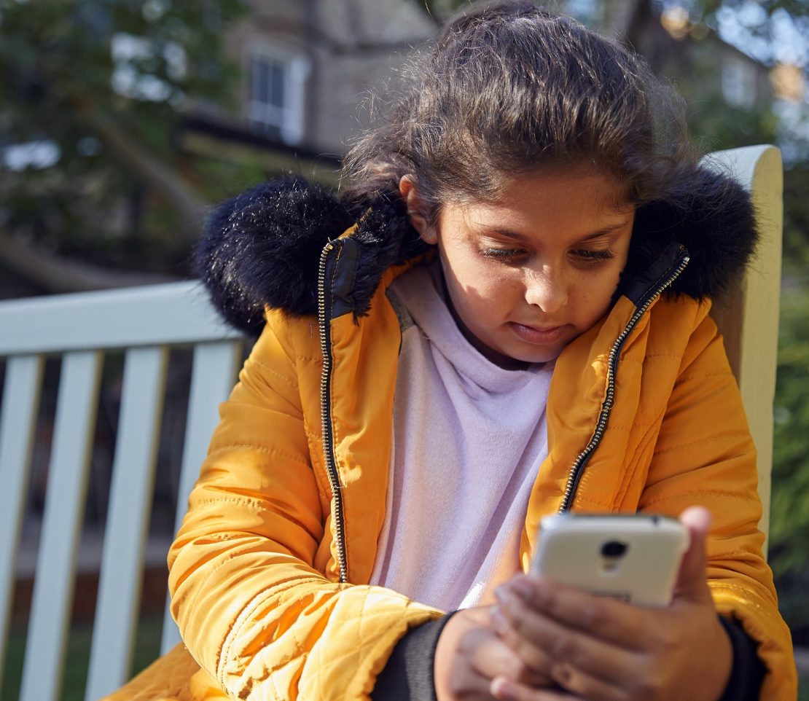

About Childline
Childline is a service just for children and young people where they can talk to someone if they're scared or worried about anything.
You can get in touch on the phone or online and can speak to Childline about anything you want to.
Click here to visit the Childline website.

Slide 4
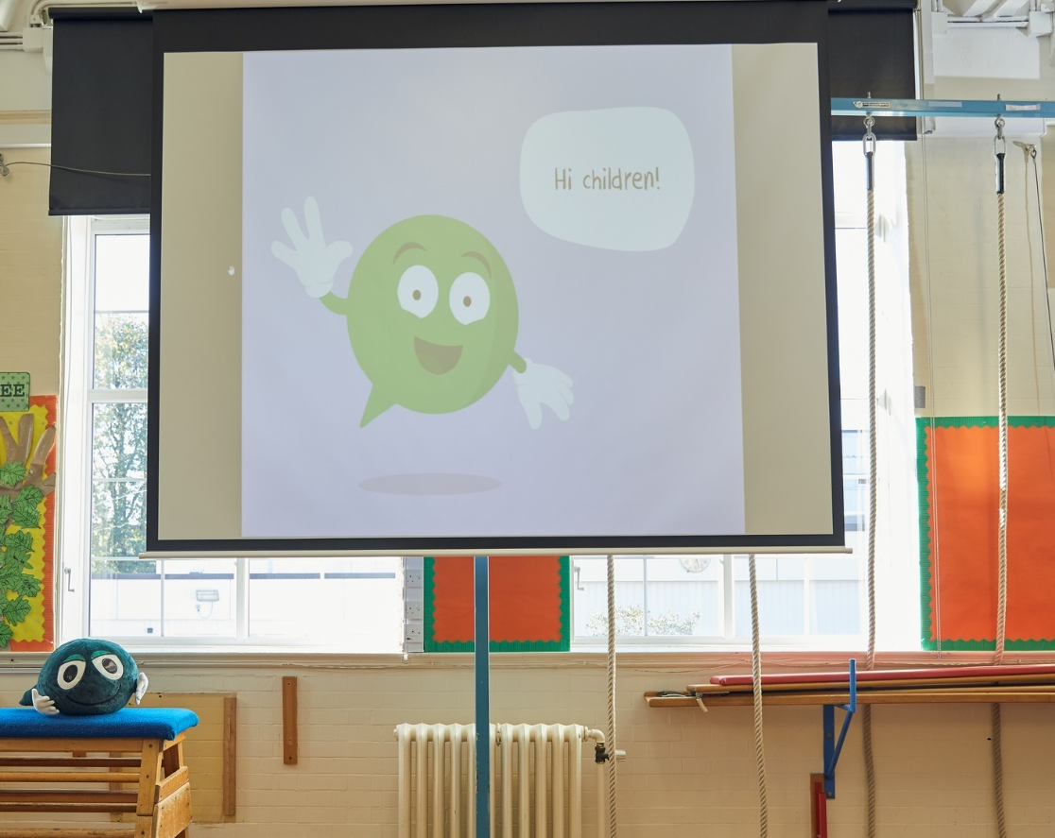
Speak out. Stay safe.
Soon, we'll be watching an online assembly from the NSPCC, about speaking out and staying safe.
You'll get to meet some of the NSPCC schools team, some special celebrities and Buddy too! But first – let's think about the rights that all children have.

Slide 5

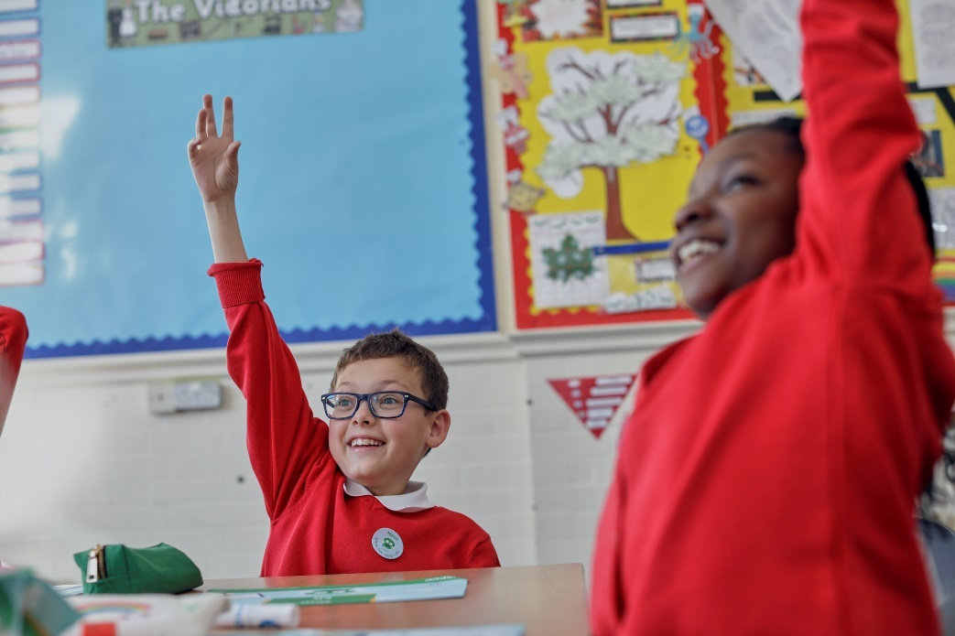



Your Rights
All humans have rights, and there are special rights for children. What do you know about your rights?
Talk to the person next to you. Discuss what you know about your rights. Share your answer if you would like to.

Slide 6
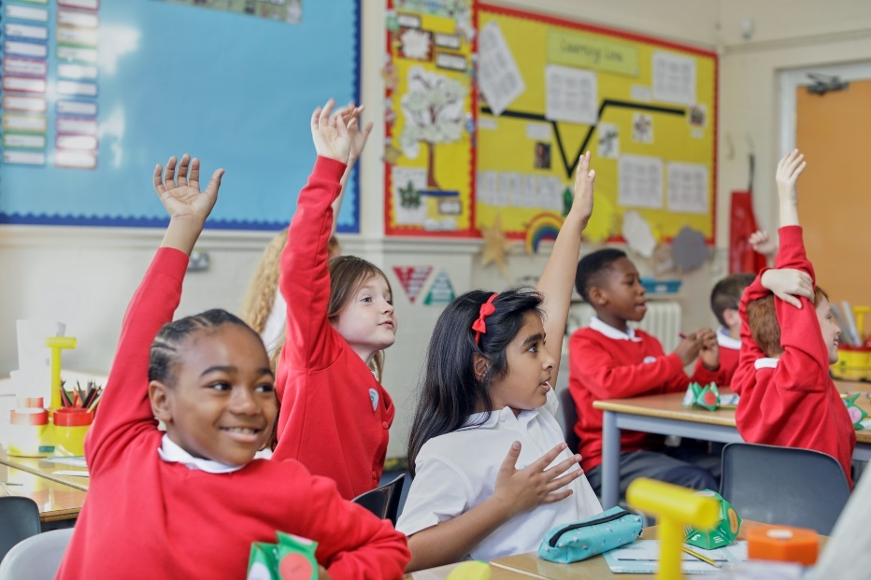

Your Rights
On the next slide, you will find just some of your rights listed.
Which of these rights are most important to you?
Discuss your answer with the person next to you and share with the class if you would like to.

Slide 7




Your Rights
You have the right
to an education.
You have the right to share your ideas and opinions.
You have the right
to a name and a nationality.
You have the
right to be safe.
You have the right to speak out and be heard if something is wrong.
You have the right to rest, play and take part in activities.
You have the right to healthcare when you are sick.
You have the right to have food, water and a place to live.
You have the right to get help when you need it.

Slide 8
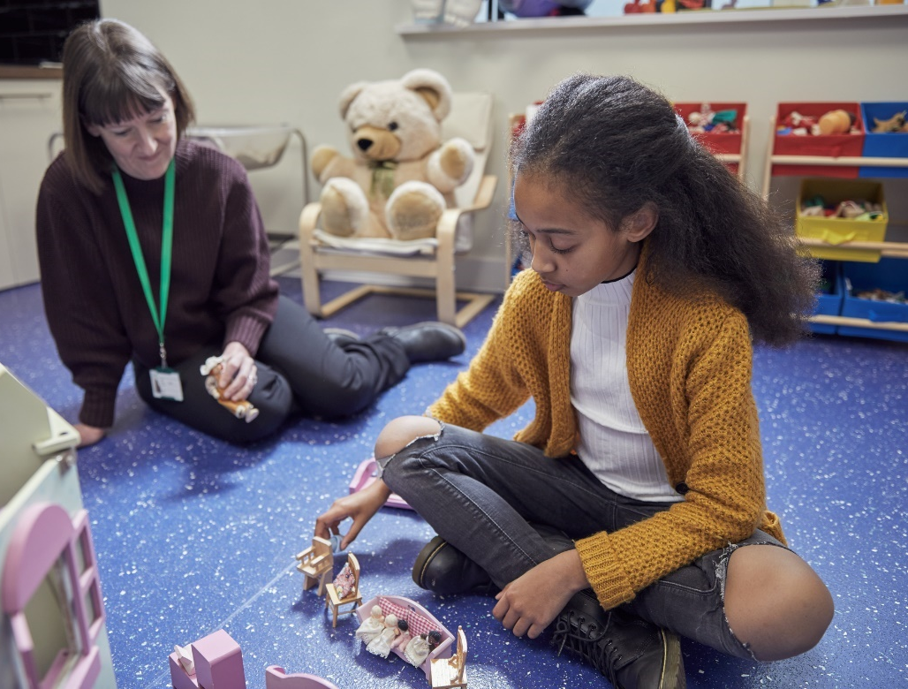
Your Rights
All children have the same rights. The adults who care for you have a responsibility to make sure that your rights are respected.
All children have the right to:
Speak out to a trusted adult
Be safe
Get help when they need it

Slide 9
What Have We Learnt?
Today, we've talked about the NSPCC online assembly we'll be watching soon.
We’ve learnt about children’s rights and discussed ones we feel are most important to us.
In the online assembly, we'll look more at these rights. You'll get to meet and find out more about Buddy too!
I have the right to speak out and be heard.
I have the right to get help when I need it.
I have the right to be safe.

